Slide 1


<Zayd Benmiloud >
<26/03/2024>

Slide 2

Outline
Executive Summary
Introduction
Methodology
Results
Conclusion
Appendix

Slide 3
Executive Summary
Summary of methodologies :
Data sources :API and SQL
Tools: Python and SQL
Visualization : scatter plots, folium maps,Dashboard
Supervised Machine learning :Classification
Summary of all results:
Since 2013,SpaceX is quite successful in recovering the first stage of its
rockets.
The payload mass, destination (orbit), and booster version play an important role in
determining the success of the landing
According to SpaceX, the continuous success of recovering the first stage after launching
rockets to the ISS or GTO orbits is not achieved. Therefore, SpaceY needs to
investigate and analyze more thoroughly.

Slide 4
Introduction
Project background and context :
SpaceY aims to enter the aerospace manufacturing sector and is intrigued by SpaceX's
experience. What makes SpaceX more attractive to clients is the low cost of the rocket,
achieved through the idea of reusing the most expensive part of the rocket - the first stage.
The main task of this project is to analyze SpaceX's launch data (Falcon 9) and predict
whether the first stage will be recovered, as well as to determine the price of rocket
manufacturing for SpaceY.
Problems you want to find answers :
How has SpaceX succeeded in recovering the first stage of the rocket ?
What are the parameters that drive success or failure ?
What does SpaceY have to do to succeed ?

Slide 5

Section 1

Slide 6
Methodology
Executive Summary
Data collection methodology:
SpaceX API and web scraping of Wikipedia page.
Perform data wrangling
Cleaning the data and structuring it.
Perform exploratory data analysis (EDA) using visualization and SQL
Perform interactive visual analytics using Folium and Plotly Dash
Perform predictive analysis using classification models
Convert all categorical variables to dummy variables (0/1) and normalize
Split dataset into training and test sets (80/20)
Train classification models with selected hyperparameters and apply on test sets
Compare confusion matrices and accuracy score to define the best performing model

Slide 7
Data Collection
Data collected of Falcon 9 from :
Wikipedia using web scraping page with
Requests and Beautifulsoup libraries.
SpaceX API with Requests library
https://api.spacexdata.com/v4/launches/past

Slide 8
Data Collection – SpaceX API
An API request, formatted as an HTTP message, was sent from SpaceY as the client to SpaceX as the resource. The response received was in JSON format, containing the requested data from SpaceX.
Collected data trough API :
Data collected using the URL as the argument in the getmethod function imported from the requests library.
Programmed and used some functions to convert response content from JSON to a DataFrame using the pandas json_normalize method.
Link:
https://github.com/Zaydbenz/testrepo1/blob/main/jupyter-labs-spacex-data-collection-api.py
SpaceY
(Client:)
API
SpaceX
(Resource: )
Data

Slide 9
Data Collection - Scraping
Scraping HTML page:
Present your web scraping process using key phrases and flowcharts
Link:
https://github.com/Zaydbenz/testrepo1/blob/main/jupyter-labs-webscraping.py
1) Install and import Requests and BeautifulSoup Libraries
2) Download webpage using URL and get_method attribute text from Requests
3) Create BeautifulSoup object from loaded page
4) Parse through HTML page

Slide 10
Data Wrangling
Check data types and identify numerical and categorical data.
Check the percentage of missing values for each column in the dataset and treat them as missing values.
Check the flight numbers performed on launch sites and orbits using the pandas value_counts method.
Create a new variable "Class" with values 0/1 indicating the success or failure of the first stage landing based on categorical variable outcomes.
Link:
https://github.com/Zaydbenz/testrepo1/blob/main/labs-jupyter-spacex-Data%20wrangling.py

Slide 11
EDA with Data Visualization
Summarize what charts were plotted and why you used those charts:
In the sense to get insight into data,in order to be able to explain launch outcomes i.e the relationship between flight numbers and payload,launch sites and orbit types were examined by scatter charts and bar plot :
Flight numbers vs payloadmass.
Flight numbers vs launch sites.
Filght numbers vs payload.
Flight numbers vs orbit types.
success rate vs orbit types.
Add the GitHub URL of your completed EDA with data visualization notebook, as an external reference and peer-review purpose

Slide 12
EDA with SQL
In this sense to have better insight into data some various SQL queries performed, among of them are listed:
Figure out the names of the launch sites existed in the SpaceX.
Figure out the total number of successful and failure mission outcomes.
Figure out List the names of the booster_versions which have carried the
maximum payload mass.
Rank the count of landing outcomes for specific dates.
Add the GitHub URL of your completed EDA with SQL notebook, as an external reference and peer-review purpose

Slide 13
Build an Interactive Map with Folium
To have better overview over rockets launch locations, in order to make map more readable and clear some map objects are added to folium map as makers,circles ,etc.
Launch site areas
Launch outcomes per site
Launch site proximity to highways, railroads, towns and coast
Add the GitHub URL of your completed interactive map with Folium map, as an external reference and peer-review purpose

Slide 14
Build a Dashboard with Plotly Dash
To enhance clarity in our dataset analysis, we've performed a dashboard to gain insights into the impact of payload mass and booster version on the landing outcome. As such, we've created two types of charts within the dashboard to effectively visualize these relationships :
Pie chart : Success rate (per site), %; and Total successful landings by site, %.
Scatter plot: Launch outcomes by site within selected payload mass range, giving insight into which
booster versions were used
Add the GitHub URL of your completed Plotly Dash lab, as an external reference and peer-review purpose

Slide 15
Predictive Analysis (Classification)
1.Import sklaern library
2.Standardize independent variables
3.Split data into training and testing sets
4.Train models using training dataset and find hyperparameters
5.Test models using test data and find best performing model
Applying the process steps described on the right. Then, we apply the four classification models and tested:
Logistic Regression
Support Vector Machine
Decision Tree
K-Nearest Neighbors
We tested the four models indicates above using the method confusion matrix and and accuracy score (score method) was calculated for each model
Link:
https://github.com/Zaydbenz/testrepo1/blob/main/SpaceX_Machine_Learning_Prediction_Part_5.jupyterlite.py

Slide 16
Results
Exploratory data analysis results for Falcon 9
The average success rate of retrieving the first stage is around 67% and around 80% in 2020
Depending on destination (orbit) and payload mass, the launch outcomes variate:
Very successful with launching heavy payload mass rockets
Very successful with launching to orbits VLEO, LEO and PO
Numerous but least successful with launching to orbits ISS and GTO
In majority of successful landings booster versions FT and B4 are used
Predictive analysis results
Due to small data sample, all four classification models tested yield appx the same results, meaning every model can be used for predicting the launch outcome, and eventually price of the rocket manufacturing

Slide 17

Section 2

Slide 18
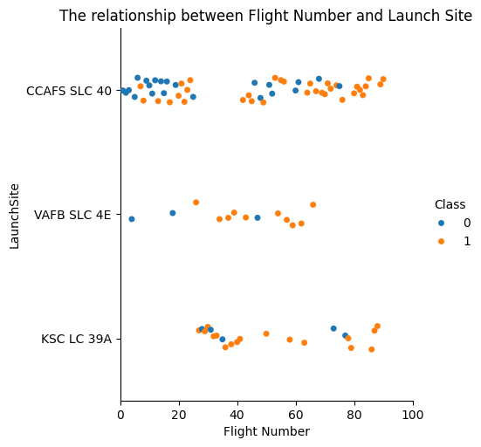
Flight Number vs. Launch Site
Majority launches took place at CCAFS SLC 40, although success rates are higher at two other sites.
More launches (continuous launch attempts) increase the likelihood of getting successful landing.
Link:
https://github.com/Zaydbenz/testrepo1/blob/main/jupyter-labs-eda-dataviz.ipynb.jupyterlite.py

Slide 19
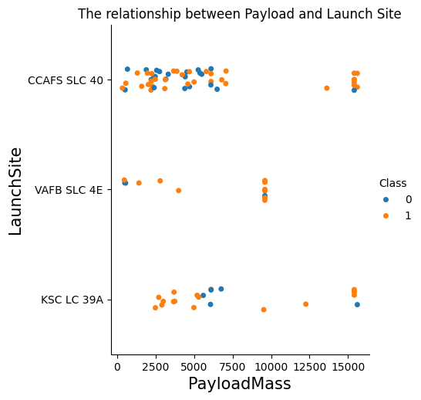
Payload vs. Launch Site
Majority of launched rockets have payload mass between 500 kg to 7000 kg
VAFB SLC 4E site has no rockets with heavy payload mass

Slide 20
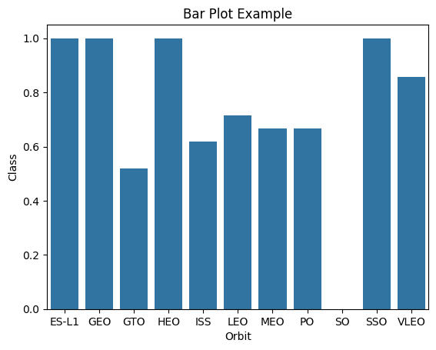
Success Rate vs. Orbit Type
Launches to orbits GTO, ISS, MEO and PO were least successful
Majority of launches happened to orbits GTO, ISS, VLEO, PO and LEO
There are few (1 to 4) launches to orbits ES-L1, GEO,HEO and SSO

Slide 21
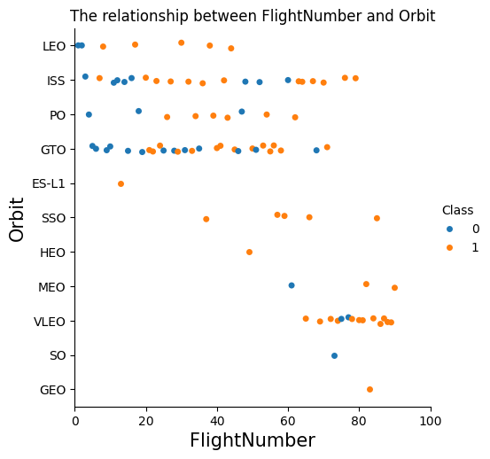
Flight Number vs. Orbit Type
Successful outcome in LEO orbit is related to the number of flights (improvement with every next launch), what’s not the case for orbits ISS and GTO

Slide 22
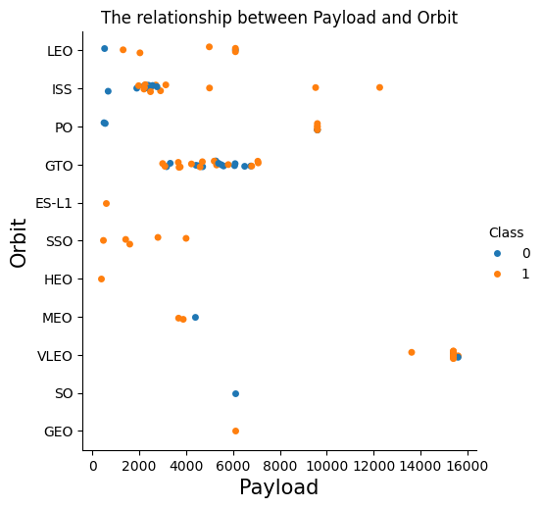
Payload vs. Orbit Type
Heavy payload mass rockets have successful outcome in orbits ISS, PO and VLEO

Slide 23
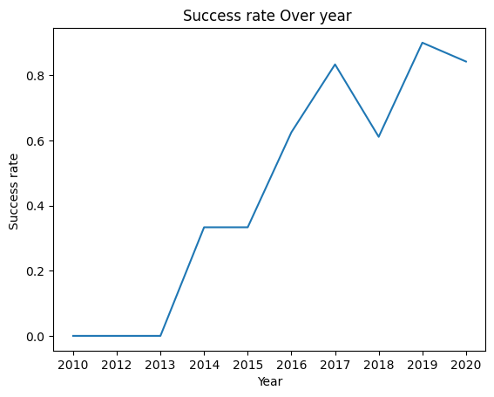
Launch Success Yearly Trend
From 2013 until 2020 success rate is increasing

Slide 24
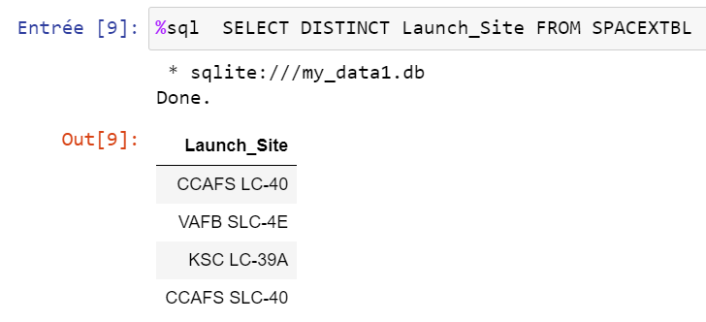
All Launch Site Names
Query result shows the names of 4 unique launch sites
SQL: keyword DISTINCT is used in SELECT statement
Link:
https://github.com/Zaydbenz/testrepo1/blob/main/jupyter-labs-eda-sql-coursera_sqllite.py

Slide 25
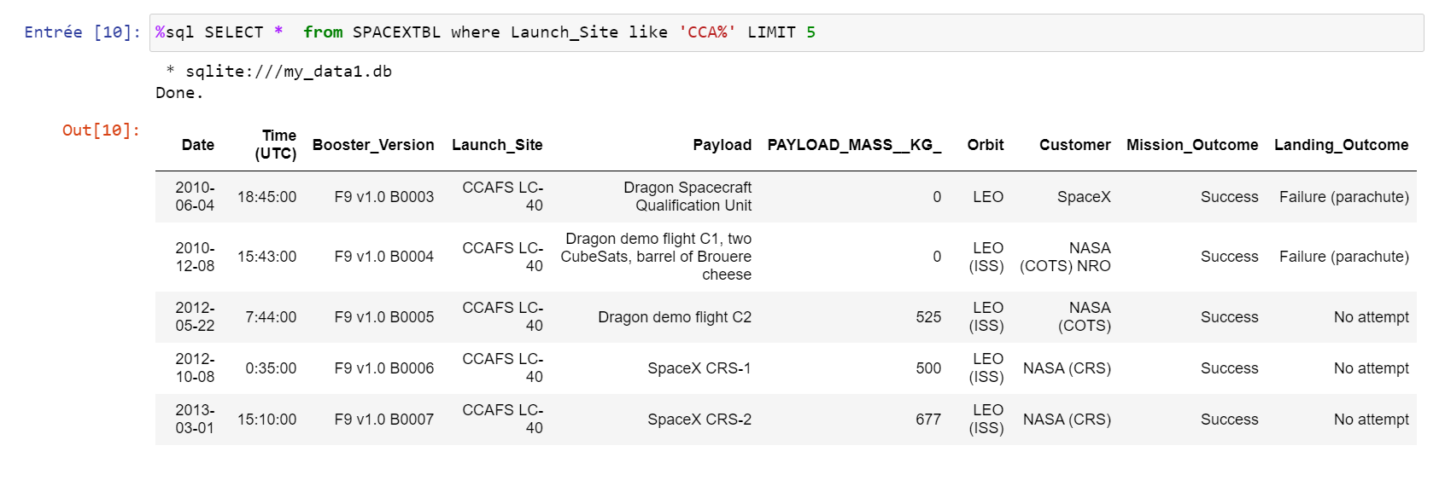
Launch Site Names Begin with 'CCA'
Query result shows 5 records where launch sites begin with `CCA`
SQL:
keyword LIKE is used to retrieve entries which contain ‘CCA’ in launch_site column
Keyword LIMIT 5 restricts the retrieved dataset to 5 entries

Slide 26
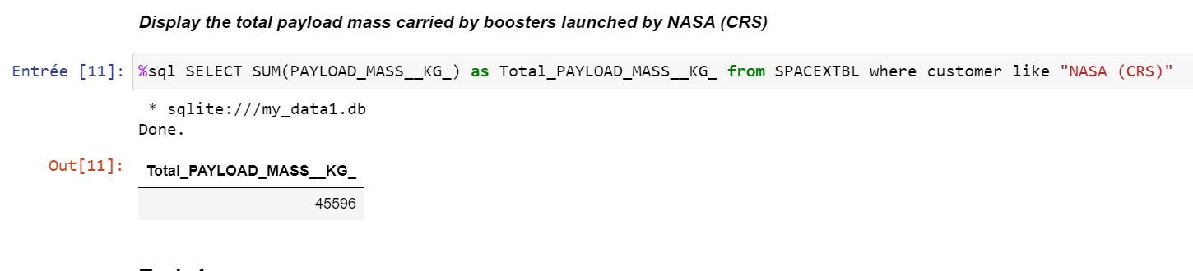
Total Payload Mass
Query result shows the total payload carried by boosters from NASA
SQL: function SUM is used to get the total sum

Slide 27
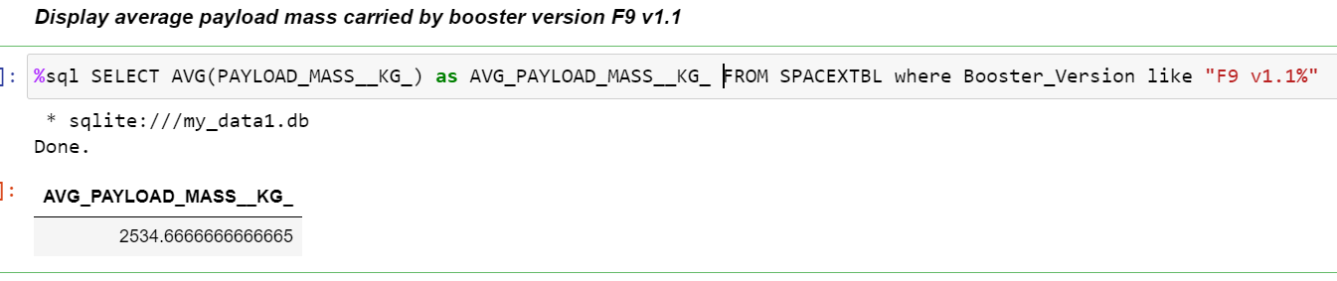
Average Payload Mass by F9 v1.1
Query result shows the average payload mass carried by booster version F9 v1.1
SQL: function AVG is used to get an average value

Slide 28
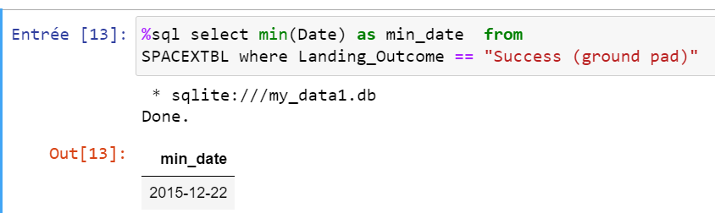
First Successful Ground Landing Date
Query result shows the dates of the first successful landing outcome on ground pad
SQL: function MIN is used to get a minimum value in a column; can be applied to date type as well

Slide 29
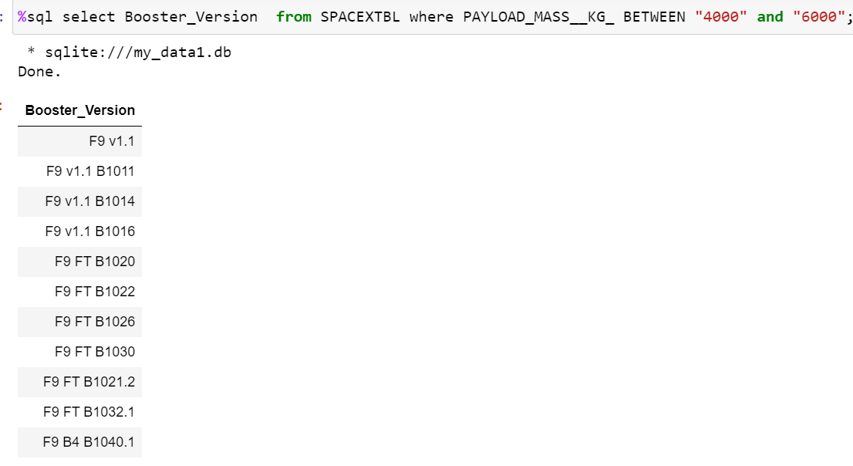
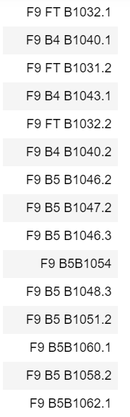
Successful Drone Ship Landing with Payload between 4000 and 6000
Query result shows the names of boosters which have successfully landed on drone ship and had payload mass greater than 4000 but less than 6000
SQL: keywords BETWEEN and AND are used to retrieve data based on several conditions in one statement

Slide 30
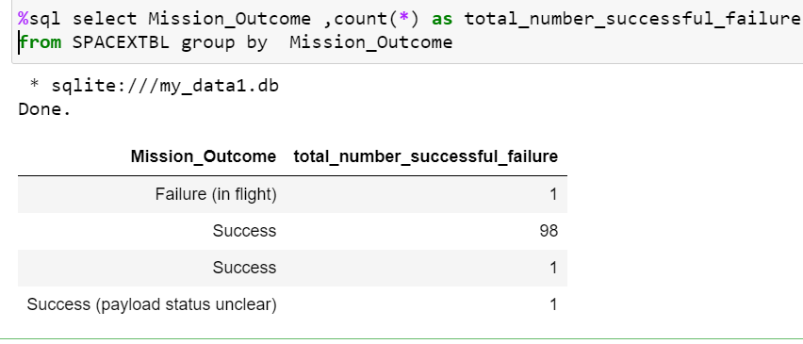
Total Number of Successful and Failure Mission Outcomes
Query result shows the total number of successful and failed mission outcomes
SQL: function Count is used to calculate the number of mission outcomes and using function groupby

Slide 31
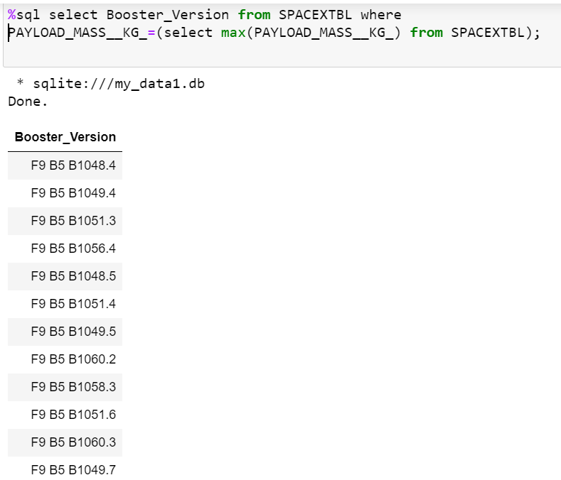
Boosters Carried Maximum Payload
Query result shows the names of the boosters which have carried the maximum payload mass
SQL: nested SELECT statement in WHERE clause

Slide 32
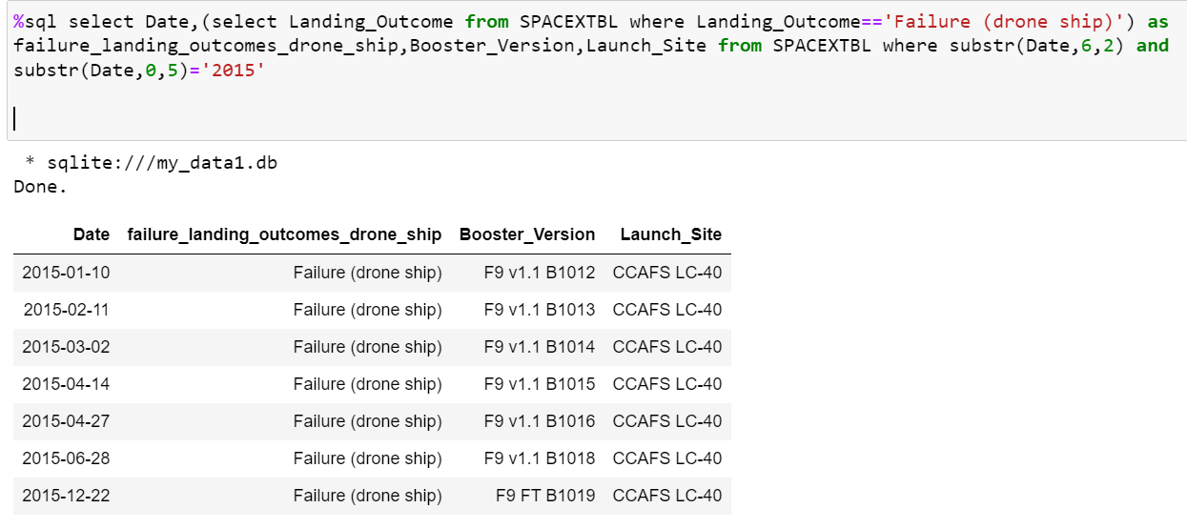
2015 Launch Records
Query result shows the failed landing outcomes in drone ship, their booster versions, and launch site names for in year 2015
SQL: function Substr() is used to retrieve year from the date

Slide 33
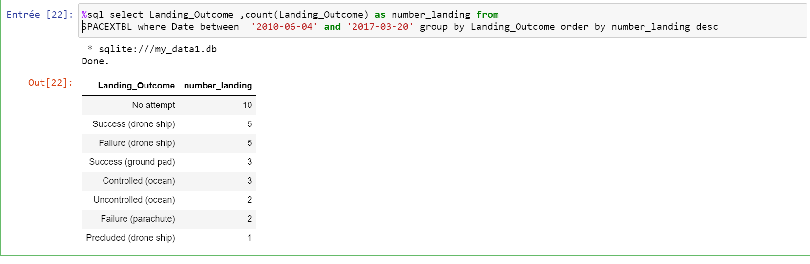
Rank the count of landing outcomes (such as Failure (drone ship) or Success (ground pad)) between the date 2010-06-04 and 2017-03-20, in descending orderQuery result shows the ranked landing outcomes (such as Failure (drone ship) or Success (ground pad)) between the date 2010-06-04 and 2017-03-20, in descending order
SQL: ranking is done with GROUP BY and ORDER BY clauses
Present your query result with a short explanation here
Rank Landing Outcomes Between 2010-06-04 and 2017-03-20

Slide 34

Section 3

Slide 35

Launch sites
Launching sites are located very close to the coastal area: VAFB SLC-4E site on west coast (California, Pacific ocean) and others on east coast (Florida, Atlantic ocean)
Sites CCAFS S/LC-40 and KSC LC-39A are closer to the equator
Link:
https://github.com/Zaydbenz/testrepo1/blob/main/lab_jupyter_launch_site_location.py

Slide 36
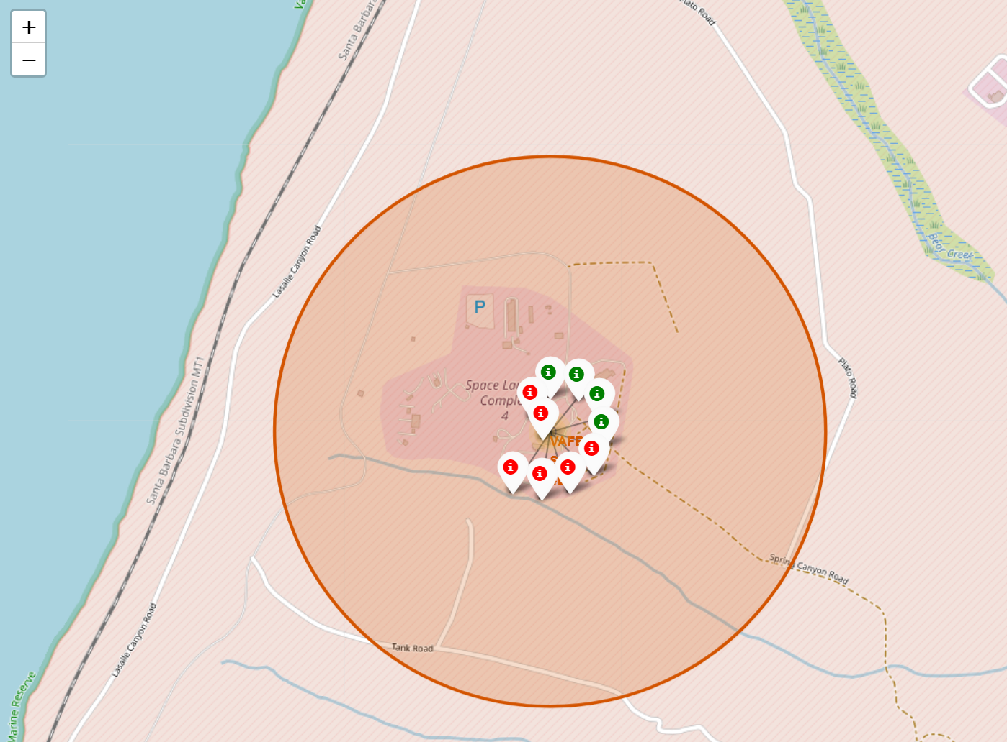
VAFB SLC-4E: launch outcomes
Out of 10 launches only 4 were successful

Slide 37
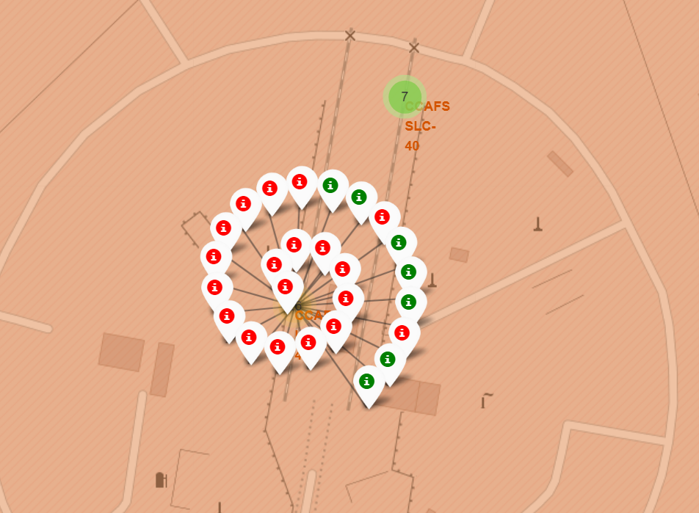
CCAFS LC-40: launch outcomes
Out of 26 launches only 7 were successful

Slide 38
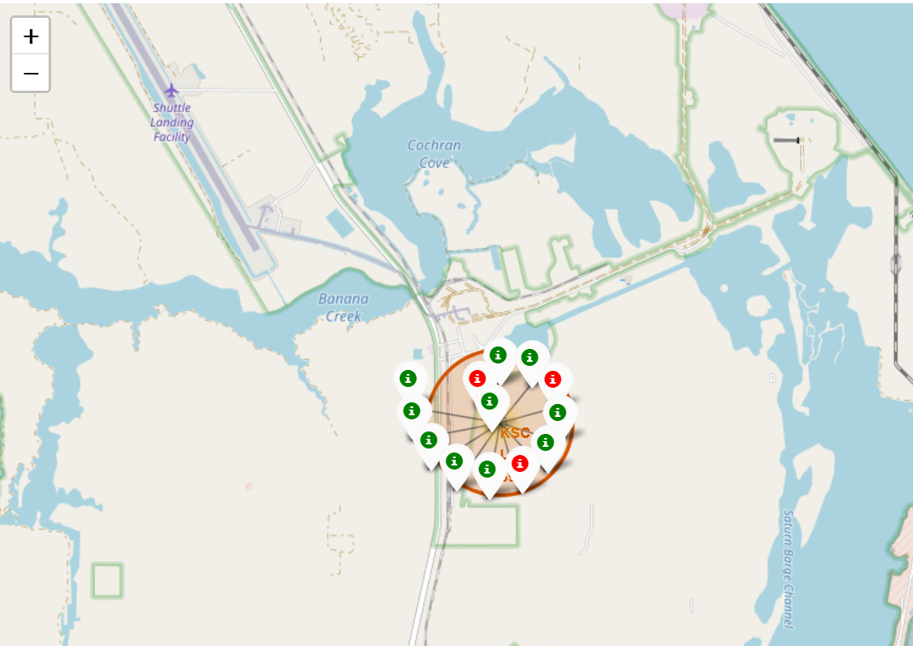
KSC LC – 39A: launch outcomes
Out of 13 launces 10 were successful

Slide 39
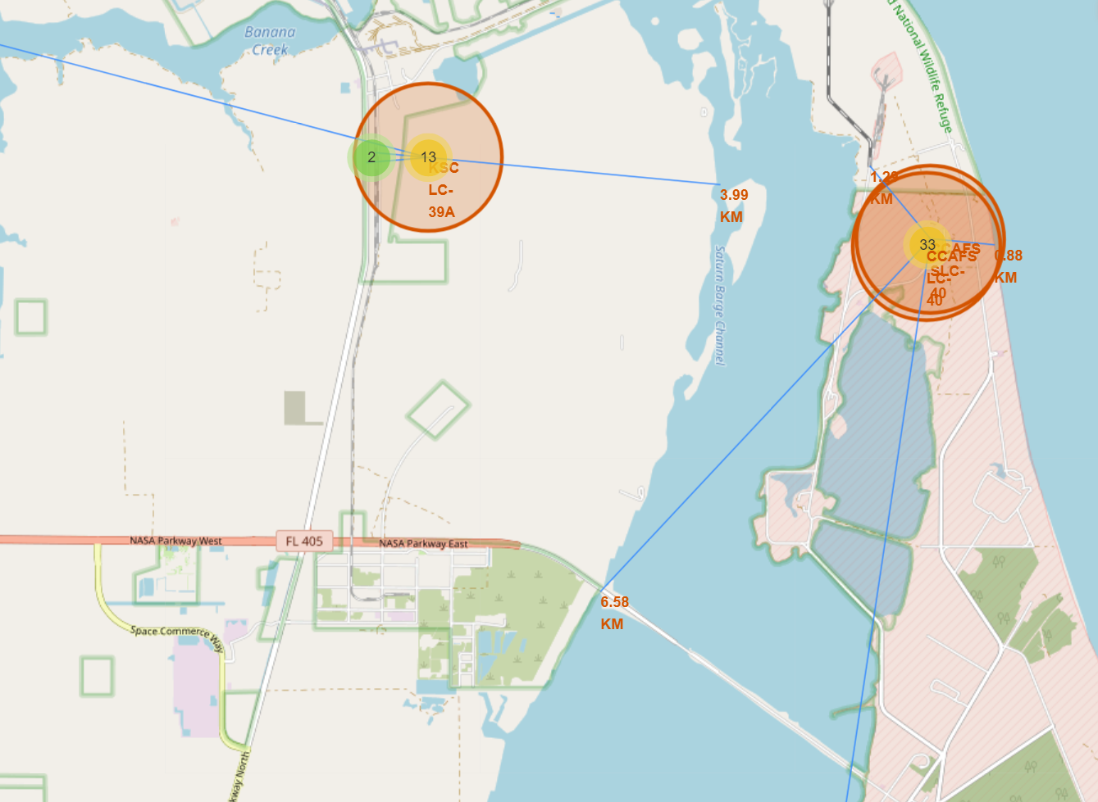
Launch sites proximity: East coast
Sites are located closer to railroads and further away from towns
Object / Site | CCAFS S/LC 40, km | KSC LC-39A, km
Coast | 0.88 | 3.99
Railroad | 1.29 | 0.72
Highway | 6.58 | 0.83
Town | 18.16 | 16.37

Slide 40

Section 4

Slide 41
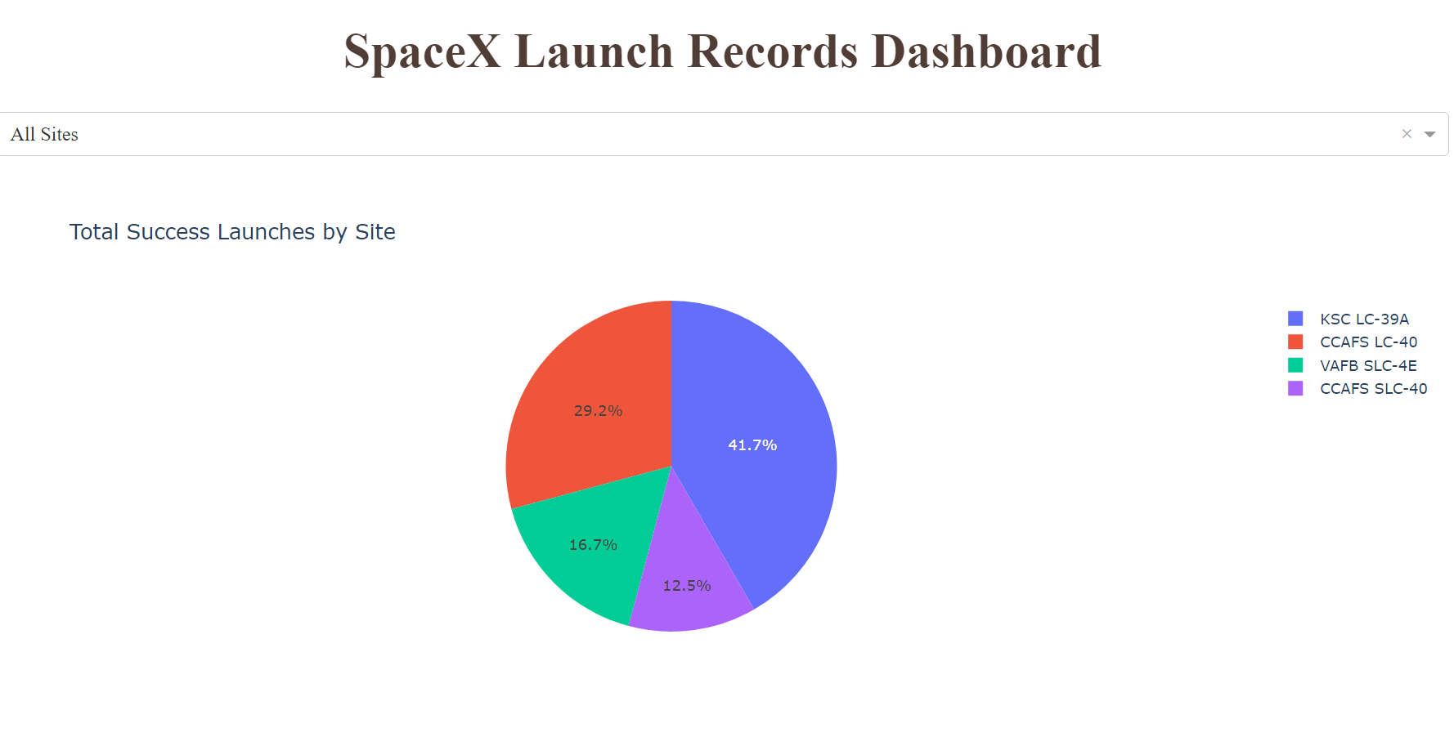
Launch sites: Success share
According to the data, around 42% of all successful rocket launch outcomes happened on site KSC LC-39A located in Florida.
Link:
https://github.com/Zaydbenz/testrepo1/blob/main/Last_Interactive_Dasboard.pdf

Slide 42
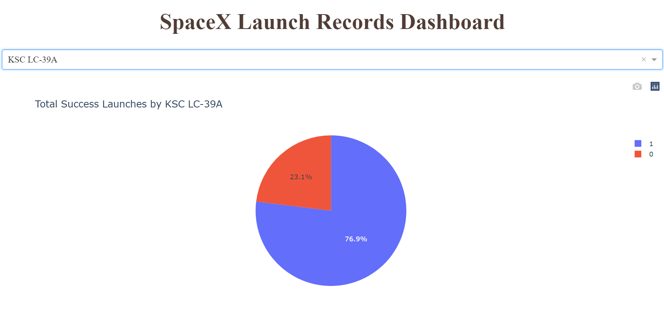
Highest launch success ratio
Among 13 launches 10 were marked as successful, yielding success ratio of 77%

Slide 43
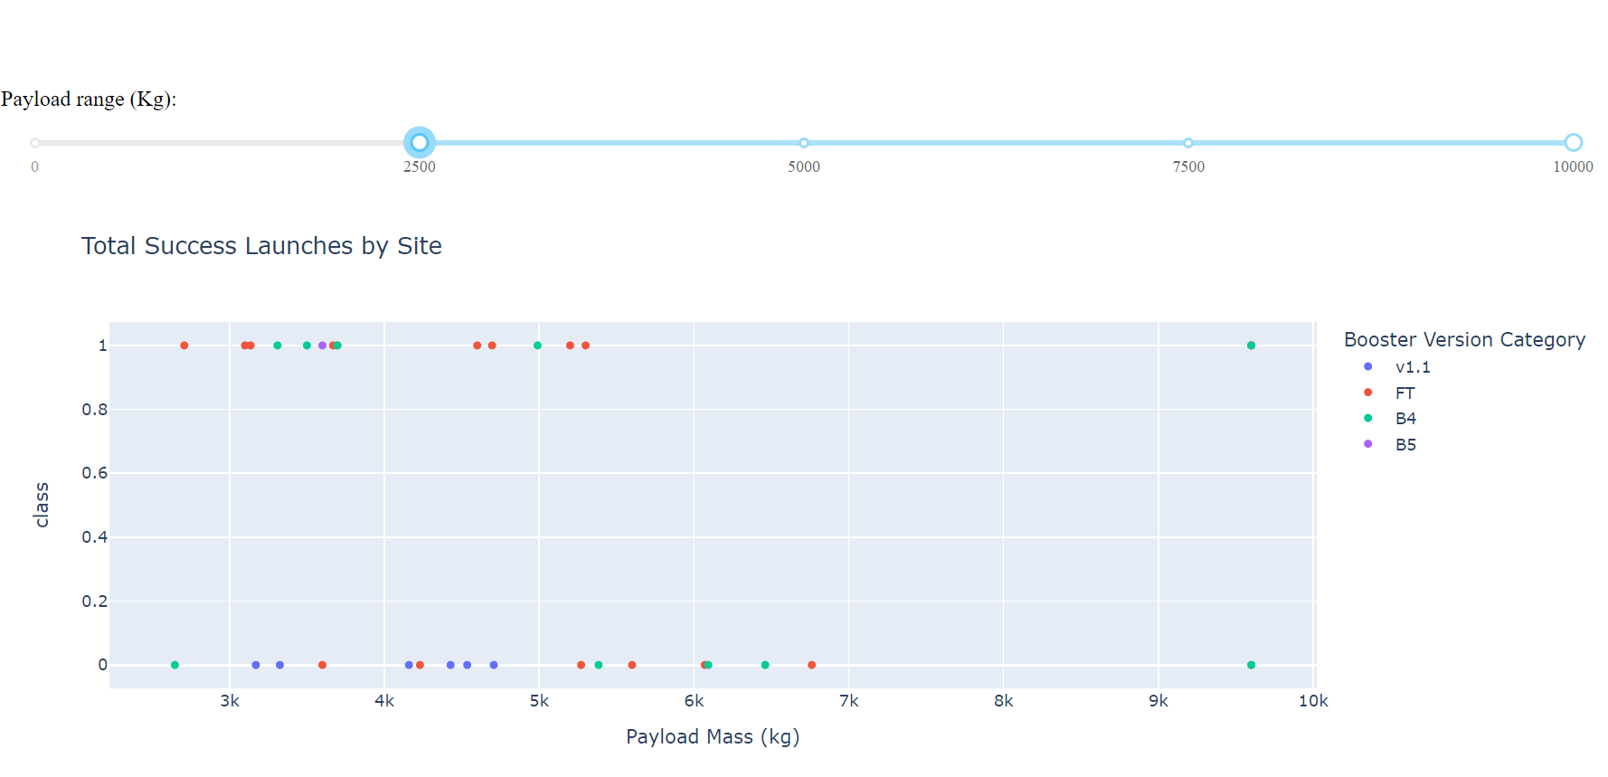
Payload mass and booster
Majority of successful launch outcomes occurred where:
Payload mass was in range from 2500 kg to 5300 kg
Booster version used was FT, followed by B4

Slide 44

Section 5

Slide 45
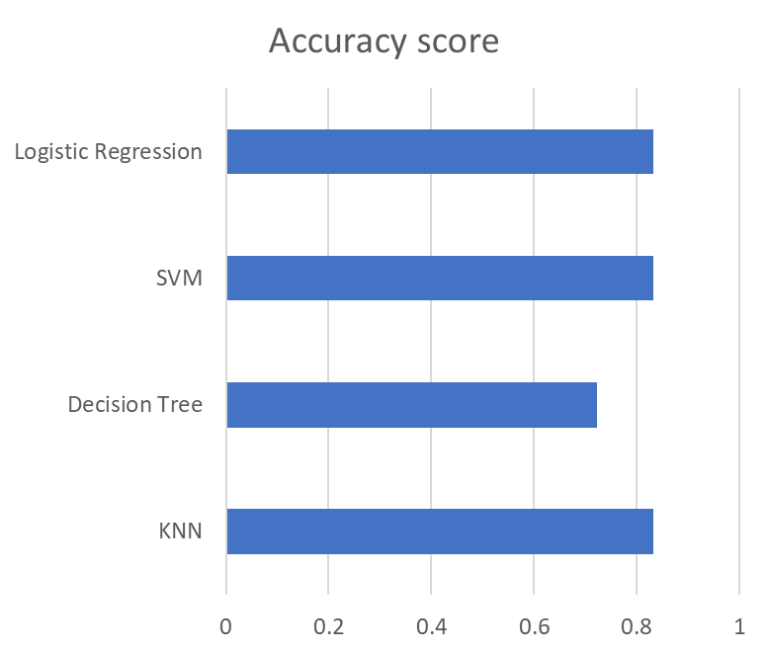
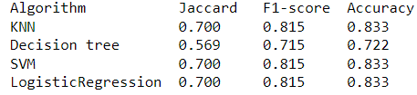
Classification Accuracy
All classification models yielded approximately the same accuracy score on test dataset, meaning that all models perform relatively well.

Slide 46
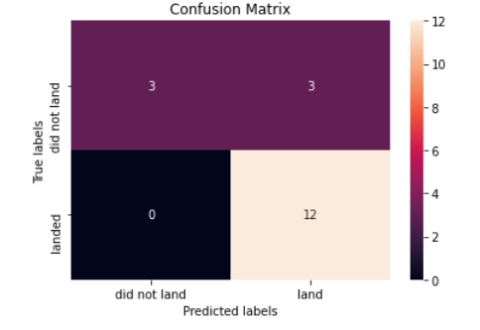
Confusion Matrix
All classification models had the same results when confusion matrices were plotted:
models were able to distinguish different classes (land / did not land)
3 landing outcomes were not classified properly (false positives)

Slide 47
Conclusions
With a collected data consisting of 90 launch entries, all tested classification models perform well and can be used to predict landing outcome and eventually price of the rocket manufacturing
To improve further model performance, collect more data on Falcon 9

Slide 48


